Slide 1
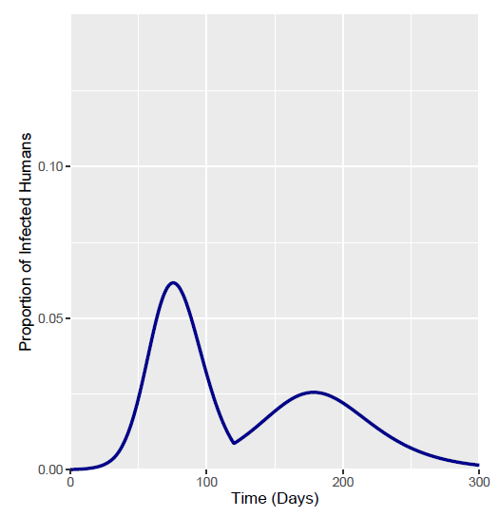
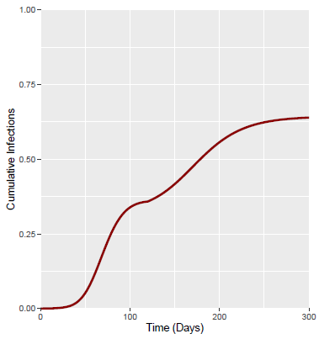
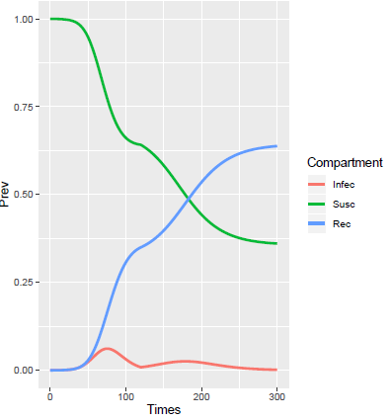
Output Measures | Value
Total Fraction Infected | 0.639
Peak Fraction Infected | 0.0616
Time of Epidemic Peak | Day 75
Day 36 Intervention

Slide 2
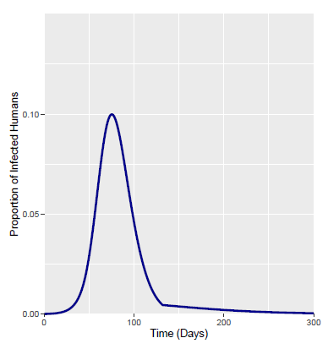
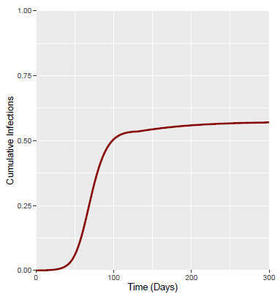
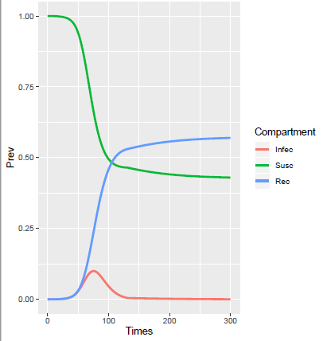
Output Measures | Value
Total Fraction Infected | 0.099
Peak Fraction Infected | 0.616
Time of Epidemic Peak | Day 75
Day 48 Intervention

